Slide 1
Do-Now

Slide 2
Geometry
Section 1.4: Measure and Classify Angles
Day 1

Slide 3
What are angles?
Angle consists of two different rays with the same endpoint.
The rays are the sides of the angle.
The endpoint is the vertex of the angle.

Slide 4
Naming Angles
You name angles with three letters.
The middle letter is the vertex of the angle and the other two letters are on the edges of the angle.
You can name an angle with one letter (the vertex) if there is only one angle coming from the vertex.
A
B
C

Slide 5
Name Angles (Ex. 1)

Slide 6
Protractor Postulate

Slide 7
Classify Angles

Slide 8
Measure and Classify Angles Example

Slide 9
Angle Addition Postulate
If point P is in the interior of ∠RST, then
m ∠RST = m ∠RSP + m ∠PST
R
P
S
T

Slide 10
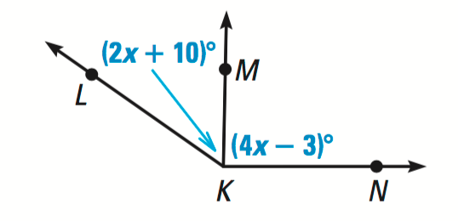
Find angle measure Example

Slide 11
Example Continued

Slide 12
Congruent Angles
Two angles are congruent angles if they have the same measure.

Slide 13
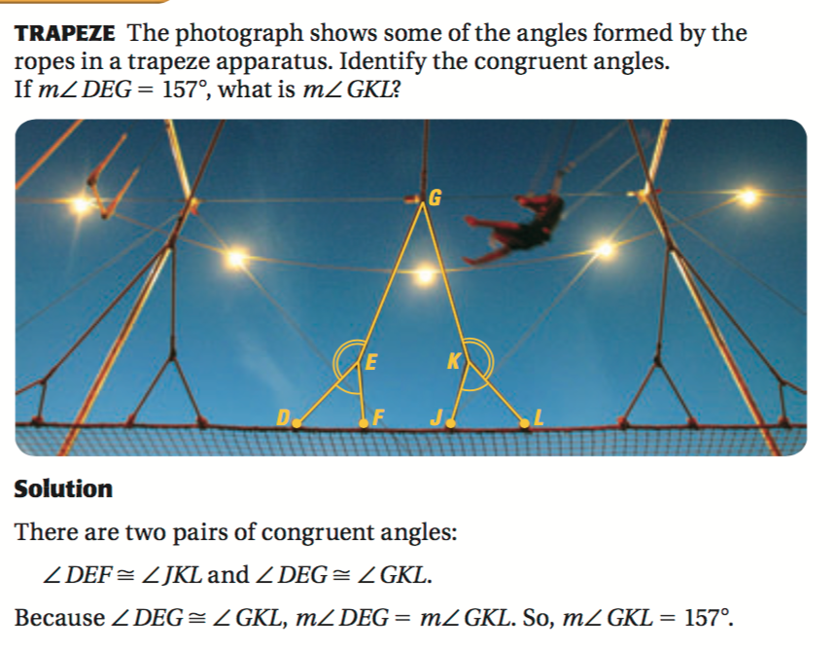
Identify Congruent Angles Example

Slide 14
Homework
Textbook pages 28-29
# 3, 15, 17, 19, 22, 25, 28

