Slide 1
Minerals Are All Around Us
Section 2.1

Slide 2
Characteristics of Minerals
A mineral is a substance that:
Forms in nature
Is a solid
Has a definite chemical makeup
Has a crystal structure

Slide 3
How are Minerals Different from “Rocks”?
Or are they different?
A rock only has two characteristics:
It is a solid
Forms naturally
Two samples of the same type of rock may vary greatly in the amounts of different minerals they contain
Minerals are always made up of the same proportions

Slide 4
Formed in Nature
All minerals are formed in nature
What does that mean?
Every type of mineral can form by processes that do not involve living things
You will learn that some minerals are also produced by living things; however, all of them are produced by nonliving processes
Some form when molten rock cools
Some form from evaporation of salt water
Some form from high pressure in the Earth
And more!

Slide 5
Solid
What is a solid?
It has a definite volume and a rigid shape
A substance that is a liquid or a gas is not a mineral
However, in some cases its solid form is a mineral
For one Extra Credit point..
Can anyone name a mineral where it is a liquid at room temperature but its corresponding solid is a mineral?

Slide 6
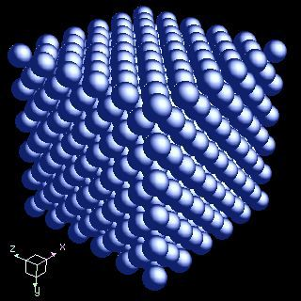
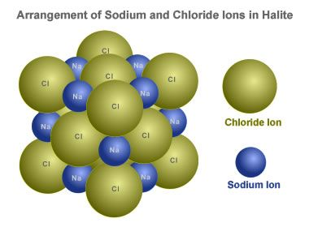
Definite Chemical Makeup
It consists of a specific combination of atoms of certain elements
Remember, an element is a substance that contains only one type of atom
Some minerals contain only one element such as gold, copper, diamond, etc.
Others have more than one element in specific proportions
Halite has one Na for every Cl

Slide 7
Crystal Structure
A crystal is a solid in which the atoms are arranged in an orderly, repeating 3D pattern
Each mineral has its own crystal structure, some minerals have the same chemical composition but different crystal structures
For example: Diamond and graphite consist of only one element… carbon
However, the arrangement of the carbon atoms are very different and have very different properties
In nature, a perfect crystal is very rare
This is because it can only form in an open space which does not happen often in the Earth’s crust

Slide 8
Crystal Groups
Crystals are named after their shapes and angle formed by imaginary lines through their centers
They belong to six groups:
Cubic
Tetragonal
Hexagonal
Orthorhombic
Monoclinic
Triclinic

Slide 9
Cubic
One of the most common and simplest shapes found in crystals/minerals

Slide 10
Tetragonal
Tetragonal crystal lattices result from stretching a cubic lattice along one of its lattice vectors, so that the cube becomes a rectangular prism with a square base (a by a) and height (c, which is different from a).

Slide 11
Hexagonal
Technically there are two types
Just know hexagonal
Forms in the shape of a hexagon when viewed from vertical axis

Slide 12
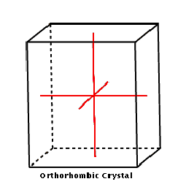
Orthorhombic
Orthorhombic lattices result from stretching a cubic lattice along two of its orthogonal pairs by two different factors, resulting in a rectangular prism with a rectangular base (a by b) and height (c), such that a, b, and c are distinct.

Slide 13
Monoclinic
They form a rectangular prism with a parallelogram as its base. Hence two vectors are perpendicular (meet at right angles), while the third vector meets the other two at an angle other than 90°
Think of it as a pushed over Tetragonal

Slide 14
Triclinic
no vector is at right angles (90°)orthogonal to another.
Think of it as a pushed over orthorhombic

Slide 16
Mineral Groupings and Silicates
They are grouped according the their chemical makeups
The most common group is silicates which contain oxygen and silicon – the two most common elements in the Earth’s crust – joined together
Only about 30 elements make up about 90% of all rocks
Some common silicates are quartz, feldspar, and mica

Slide 17
Carbonates
Second most common group
Contain carbon and oxygen together in a mineral
Seashells are made of a carbonate called calcite

Slide 18
Other Mineral Groups
Oxides contain the minerals from which most metals, such as tin and copper, are formed
An oxide usually consists of an element, usually a metal, joined to oxygen
This group includes hematite, a source of iron

