Slide 1
Most Fungi are decomposers
Section 2.4
By: Jeffrey, Rameses, Macyn, Ava. M, Leylani

Slide 2
Vocabulary
Hyphae: Threadlike structures formed by a network of cells
Spore: A single reproductive cell that can grow into a multicellular organism.
Lichen: When fungi forms a sandwich-like structure for single-cell algae

Slide 3
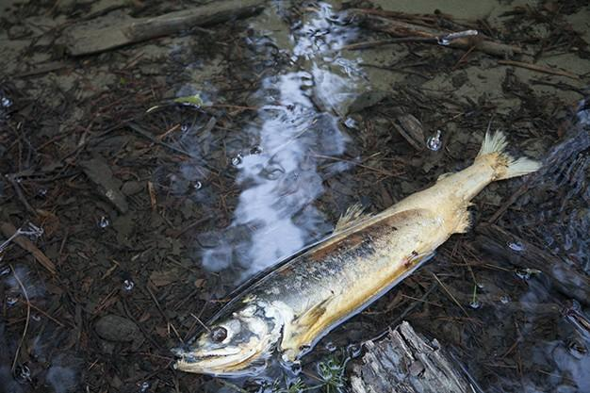
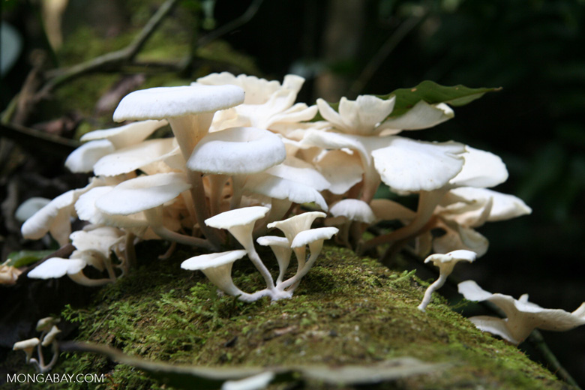
Decomposer
Fungi can decompose dead animals and plants. They absorb nutrients and leave behind simpler compounds

Slide 4
Fungi absorb materials from the environment
Most fungi are decomposers
They decompose, or break down complex carbon compounds that are part of living matter. They decompose the complex carbon compounds that plants build from the sun.
Just like animals, fungi are heterotrophs
They decompose materials such as leaves and animal waste

Slide 5
Fungi Characteristics
All fungi are multicellular, except for yeast
Their cells have a nucleus and a thick cell wall
They don’t possess tissues or organs. Instead it is made up of a reproductive body and network of cells that form threadlike structures called hyphae
Mycelium
Mycelium is a mass of hyphae
The mycelium are close to the soil or substance where the fungus/fungi are living in.

Slide 6
Reproduction
Most fungi reproduce with spores. The spores can be produced by either asexual reproduction or sexual reproduction
These spore-producing structures are reproduced bodies of mushroom .
A single mushroom can produce billions of spores.
Spores are released into the air, and because they’re so small and light, the wind can carry spores long distances
The spores are like rain when reproduction
A single spore can produce billions of spores

Slide 7
Reproduction continued
Fungi can reproduce in other ways, too
A multicellular can reproduce sexually when hyphae break off and form a new mycelium
Single-celled fungi, such as yeast, reproduce asexually by budding or basic cell division
https://youtu.be/Mrphn1zOWaE

Slide 8
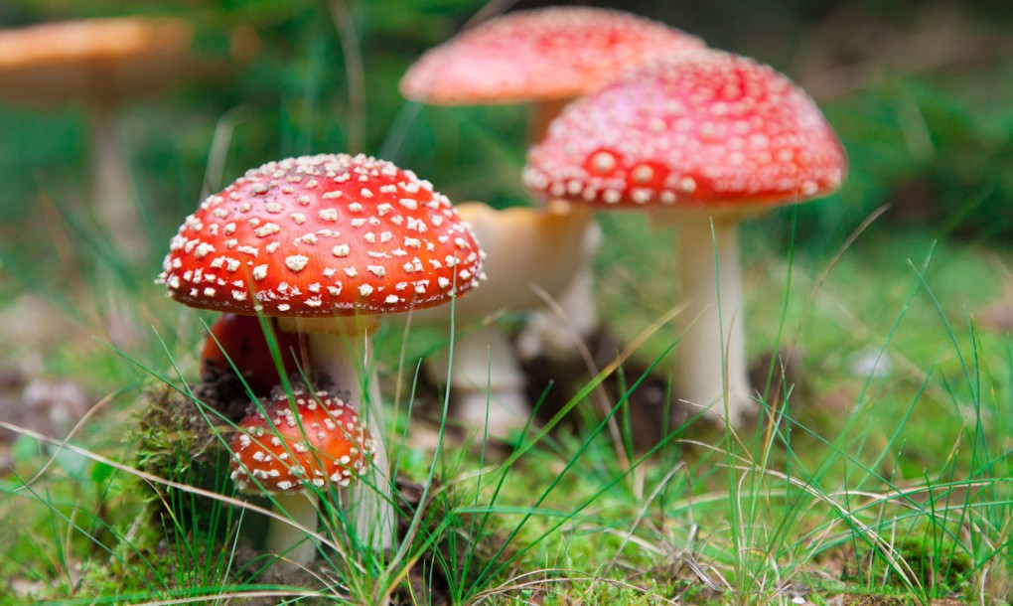
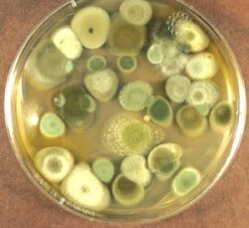
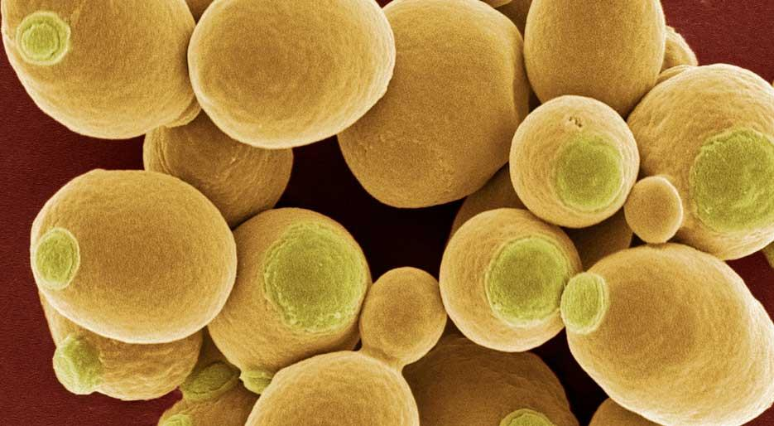
Fungi include:
Mushrooms
Mold
Yeast
Mushrooms->
Mold->
Yeast ->

Slide 9
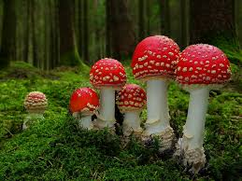
Mushrooms
A mushroom is only a small part of a fungus
The mushrooms we purchase at the store may come from mycelium that can grow up to 30 meters across
Although mushrooms are delicious, some may be quite deadly. The toadstool mushroom is an example of a mushroom we can’t eat. Toadstool Mushroom
Do not eat this->

Slide 10
Molds
They are the spore-producing part of another fungus
The reason they grow into food is because of the hyphae. The food is the food for the hyphae.
Not all molds that grow on food are bad
Many molds can cause disease like listeria, athlete’s foot .
Molds produce by spores as well
Molds like pilobolus have spore caps and a stalk

Slide 11
Yeasts
They are singled celled fungi
They can grow in most environments. They can even grow in tree sap, animal tissues, shower curtains, and even human skin. If produced to quickly, it can cause disease
They are used for cooking purposes. It helps bread rise. This specific material in the yeast has been carefully studied by scientists.

Slide 12
Fungi can be helpful or harmful to other organisms
Along with bacteria, fungi function as the main decomposers on Earth
They may decompose living matter, dead matter, or waste left by another organism which leaves simpler compounds and helpful nutrients that a plant uses to restart this cycle all over again
It can give back nutrients for a dead tree back into the soil
Many fungi can release toxins, or harmful chemicals, back in the environment.
In the year of 1845, one fungus killed a farmer’s crops in Ireland which dramatically decreased the population of Ireland from 8 million to 4 million.
We can use a toxin that a fungi produces, penicillin, by preventing bacteria to reproduce by destroying its cell wall.

Slide 13
Fungi Fun Facts
Scientists who specialize in the study of fungi are called mycologists.
The fungi kingdom is more similar to the animal kingdom than the plant kingdom.
The word “Fungus” is the latin word meaning “Mushroom”.
It is an estimate that there are at least 1.5 million different species of Fungi.
Fungi can’t make their food from sunlight so, they eat off other organisms. That is why they are closer related to the animal kingdom than the plant kingdom.

Slide 14
Review Questions
Describe the structures of a fungus .
How do fungi reproduce?
Describe two relationships between fungi and other organisms.
Analyze: Scientists used to classify fungi as plants. Today scientists say that fungi are more like animals than plants. How are fungi like plants? How are fungi like animals?
Predict: What might change in an environment where there were no fungi?

Slide 15
Review Question answers
Describe the structure of a fungus: Multicellular decomposers with thread like structures called hyphae instead of tissues or organs. Cells consist of a nucleus with a thick cell wall.
How do fungi reproduce?: Through spores, which can be produced either sexually or asexually. Most fungi reproduce asexually.
Describe two relationships between fungi and other organisms: Just like animals, fungi are heterotrophs; They decompose the complex carbon compounds that plants build from the sun.
Analyze: Scientists used to classify fungi as plants. Today scientists say that fungi are more like animals than plants. How are fungi like plants? How are fungi like animals?;Like animals, fungi are multicellular; fungi cells have a cell wall, just like plant cells

Slide 16
Review questions continued (again)
5.What might change in an environment where there were no fungi; Nothing will decompose and the world would be filled with waste. There would be no more decomposers on Earth besides bacteria. The trees wouldn’t be able to receive the nutrients that fungi release into the soil which will lead to more dead trees.

Slide 17
THE END

