Slide 1
Different cells perform various functions
Section 1.3

Slide 2
Archaea and Bacteria
One of the most recent discoveries (1980’s), scientists discovered unicellular organisms living in very extreme environments
Some were deep in the ocean at thermal vents where there is extreme heat and NO oxygen
Others found in the salty waters of Great Salt Lake and hot sulfur springs of Yellowstone
Initially these were referred to as archaebacteria
Many live in places that were like ancient Earth

Slide 3
Domain - Archaea
However, they then realized they were genetically very different from bacteria
Made a separate category for them called Archaea
Bacteria are in their own domain now!
Bacteria and Archaea are similar in many ways…

Slide 4
Similarities of Bacteria and Archaea
They are both prokaryotes
What does this mean again?
Their cytoplasm contains ribosomes but does not have organelles, so they have a simple structure
They all have a tough cell wall, a feature of prokaryotes

Slide 5
Domain - Eukarya
The third domain
Organisms in this domain have cells with a….
Nucleus!
The cells are more complex in structure with organelles
What things do you think are in this Domain?
Mostly composed of multicellular organisms like plants and animals

Slide 6
Paramecium
This is an example of a very complex eukaryote that is UNICELLULAR
It has hair-like strands called cilia that allow it to move
It also has a long oral groove lined with cilia that leads to a mouth pore
It has everything it needs to survive
By comparison, no individual cell in a multicellular organism can survive on its own
https://www.youtube.com/watch?v=l9ymaSzcsdY

Slide 7
Specialization
Cells in multicellular organism consist of many types to carry out many functions
Specialization of cells means that specific cells perform specific functions
In humans, we have blood cells, skin cells, brain cells, etc; each carry out a different function
In plants, some do photosynthesis, some are in the roots, some provide structure, etc

Slide 9
A Community of Cells!
Complexity and size can vary significantly
A sponge is relatively simple but still has specialization
In complex organisms, cells are not only specialized but grouped into tissues!
A tissue is a group of similar cells that are organized to do a specific job
Humans have over 200 types of tissues!
Who can name a type of tissue?

Slide 10
Organs
Groups of tissues come together to form an organ that work together to perform a particular function
Can you name an organ?
What about an organ in a plant?
Different organs and tissues work together to form organ systems
Humans have about 40 organs

Slide 11
Organ Systems
Humans have 11 major organ systems!
Can we name some?
Plants have organ systems as well
Can we name them?

Slide 12
Organism
This is the highest level of organization
We have trillions of cells in our body making up tissues, making up organs, which make organ systems, and allow our organism to work!
Organism => Organ Systems => Organ => Tissues => Cells

Slide 13
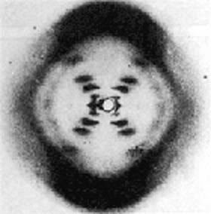
Scientists Use Models to Study Cells
We used three dimensional models to study cells
DNA is the genetic material common to all cells
How did we figure out the code to DNA?
In the 1950s, a famous scientist by the name of Rosalind Franklin used X-Rays to produce the first image of DNA!

Slide 14
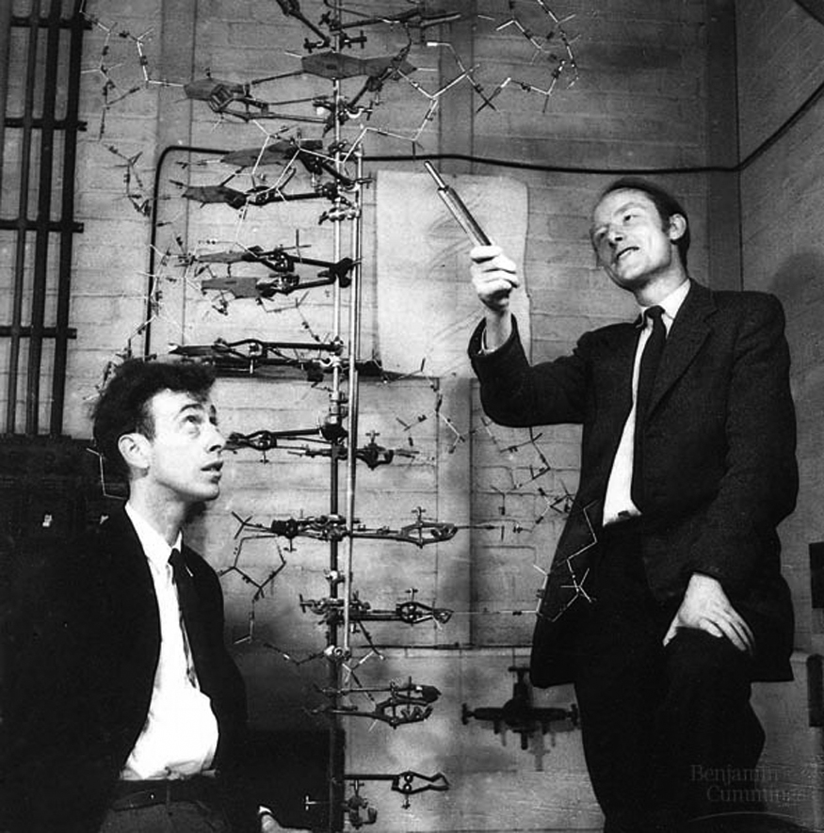
DNA Model
Her amazing discovery was the foundation for Watson and Crick who were then able to put together the first 3D model of DNA!

