Slide 1
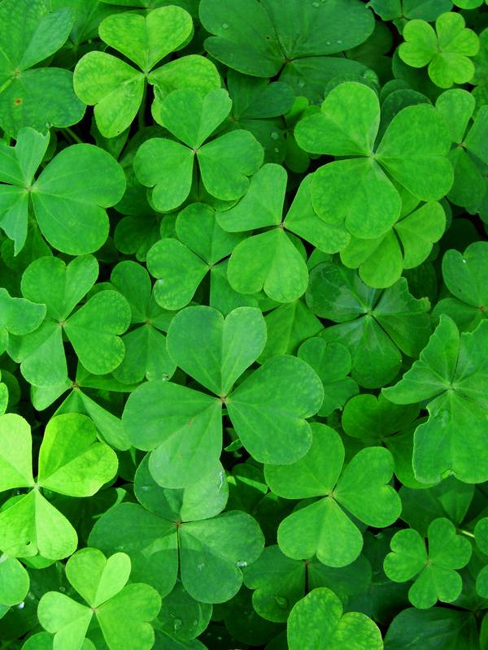
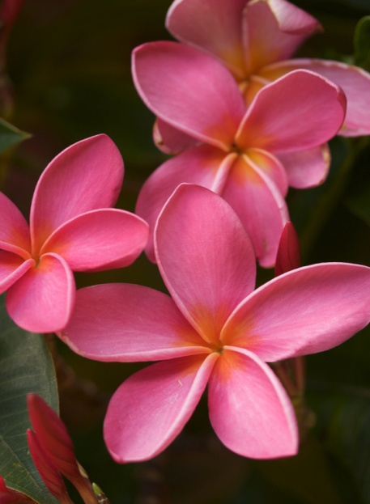
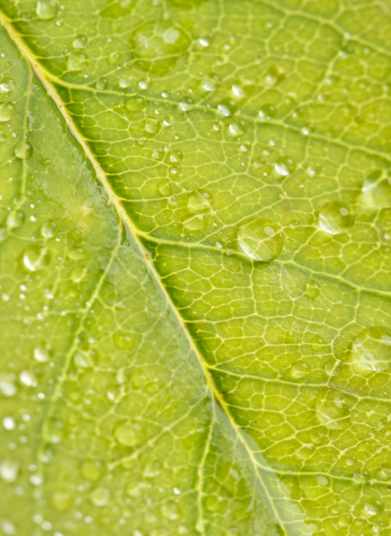
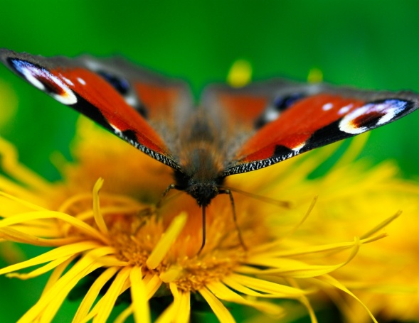
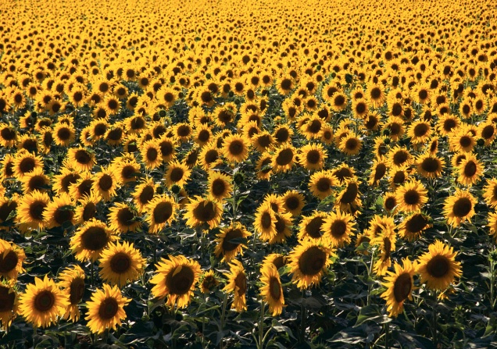
Photosynthesis &
Respiration

Slide 2
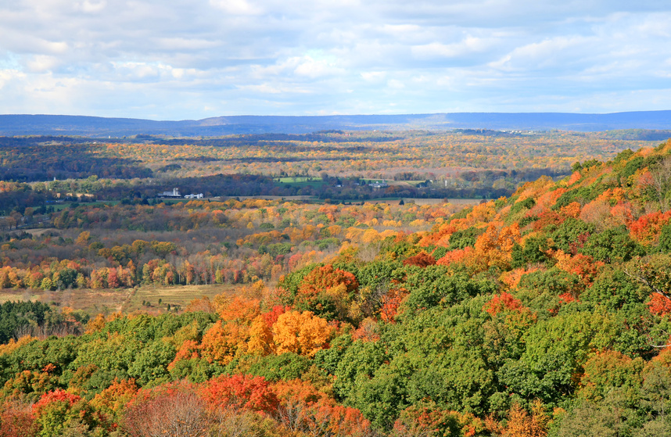
Photosynthesis

Slide 3
Overview
All energy on earth comes from the sun.
We depend on:
  Plants
  Algae (underwater plants)
  Cyanobacteria (photosynthetic bacteria)
    To provide this energy to us!

Slide 4
Photosynthesis Vocabulary
Photosynthesis- A process by which plants convert sunlight, water, and carbon dioxide into food energy (sugar), oxygen and water.
Chloroplast- An elongated cell organelle containing chlorophyll where photosynthesis takes place.
Chlorophyll- A green molecule which uses light energy from sunlight to change water and carbon dioxide gas into sugar and oxygen

Slide 5
Photosynthesis Equation
H2O + CO2 + light → O2 + C₆H₁₂O₆
Water+ Carbon + sun → Oxygen + glucose
Dioxide (sugar)

Slide 6
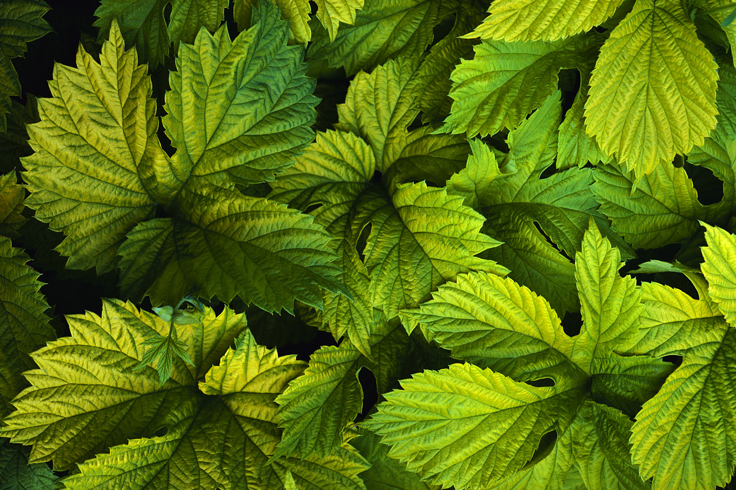
The chlorophyll absorbs the sunlight.
Chlorophyll is the green pigment inside the chloroplasts of plant cells that makes leaves green!

Slide 7

Chlorophyll then uses sunlight to change water, carbon dioxide and, nutrients from the soil.
CO2

Slide 8
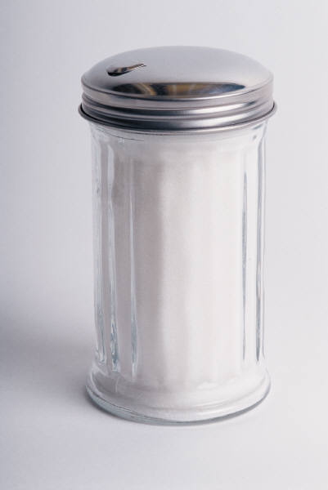
The chlorophyll processes the ingredients to make sugar (plant food) and oxygen.
O₂
Sugar + O2

Slide 9
Overview
Carbon dioxide and water are taken in by plants
Plants absorb light energy and convert it to a usable form.
  ATP
Energy is used to “fix” carbon dioxide into sugar molecules
  Chemical energy
Sugar is converted to starch and stored for use by the plant, and by animals when they eat plants.

Slide 10
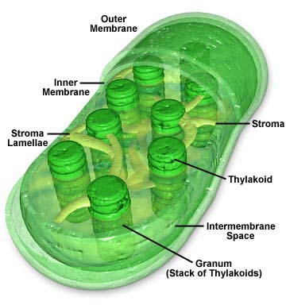
Chloroplasts
Have TWO membranes
  A “bi-bilayer!”
The inner membrane is called the thylakoid.
The thylakoid is folded and looks like stacks of coins called granum (grana singular).
The stroma is the space surrounding the granum
Image source: http://www.daviddarling.info/encyclopedia/C/chloroplasts.html

Slide 11
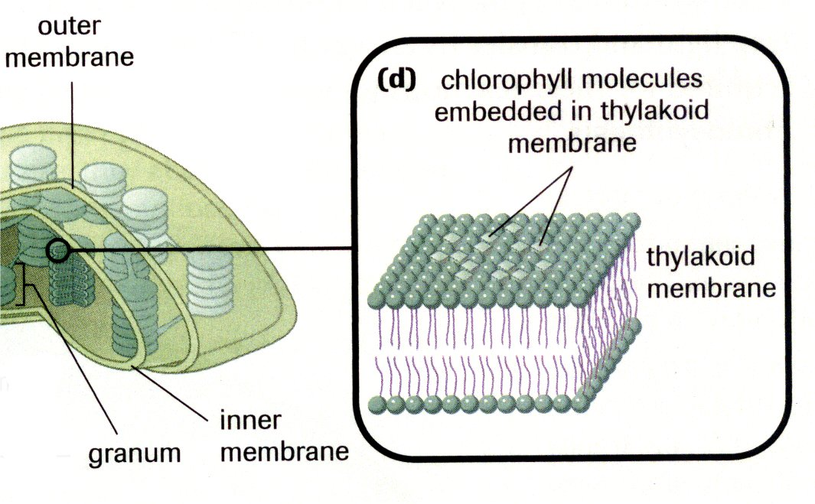
Chloroplasts
Chlorophyll molecules are embedded in the thylakoid membrane
Act like a light “antenna”
These molecules can absorb sunlight energy.
Image from Biology 11: College Preparation. Pg 73. Nelson, Toronto. 2003.

Slide 12
Overall Reaction
What is the equation for photosynthesis?
carbon dioxide + water → glucose + oxygen + energy
6CO₂ + 6H₂O → C₆H₁₂O₆ + 6O₂ + energy

Slide 13
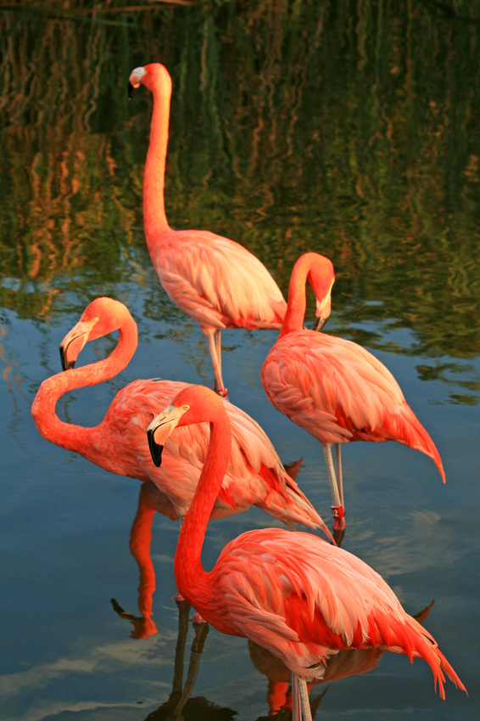
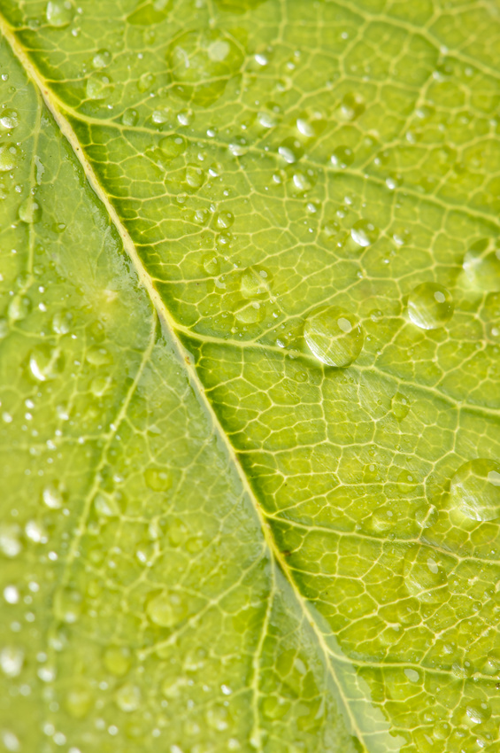
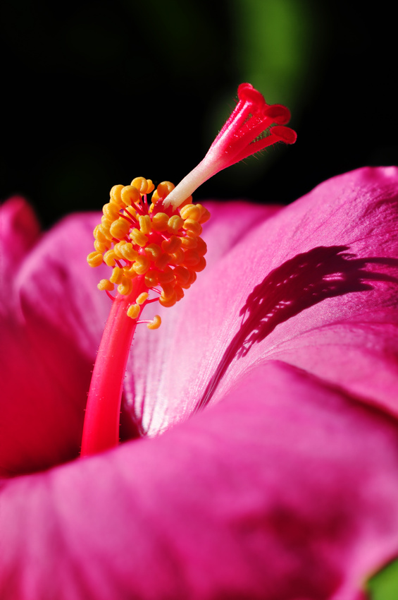
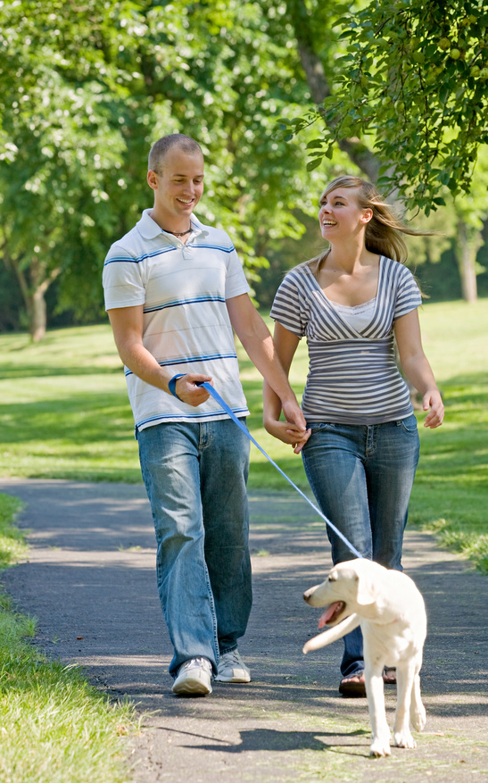
But, what about animals ?
Animals make the CO₂ plants need
Plants make the O₂ animals need

Slide 14
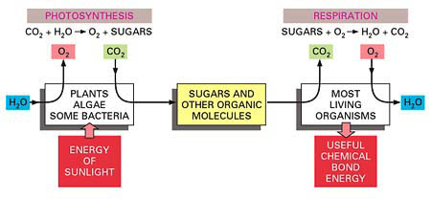
Respiration vs. Photosynthesis
Photosynthesis and respiration as complementary processes in the living world.
Photosynthesis uses the energy of sunlight to produce sugars and other organic
molecules. These molecules in turn serve as food. Respiration is a process that uses
O₂ and forms CO₂ from the same carbon atoms that had been taken up as CO₂ and
converted into sugars by photosynthesis. In respiration, organisms obtain the energy
that they need to survive. Photosynthesis preceded respiration on the earth for probably
billions of years before enough O₂ was released to create an atmosphere rich in oxygen.
(The earth's atmosphere presently contains 20% O₂.)

Slide 15
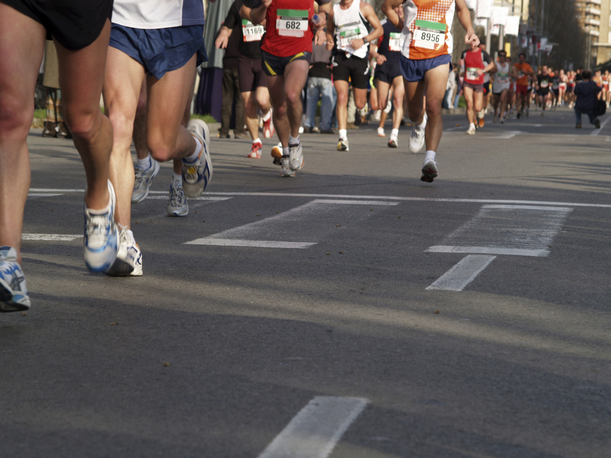
Respiration

Slide 16
Respiration Vocabulary
Respiration- The process by which the chemical energy of "food" molecules is released and changed into ATP.
Mitochondria- Rod-shaped organelles with a double membrane which converts the energy stored in glucose into ATP for the cell.

Slide 17
Respiration Equation
6 O2 + C₆H₁₂O₆ → 6 H20 + 6 CO2 + ATP
Oxygen + glucose → water + carbon + energy
(sugar) dioxide
Do you notice something about this equation?

Slide 18
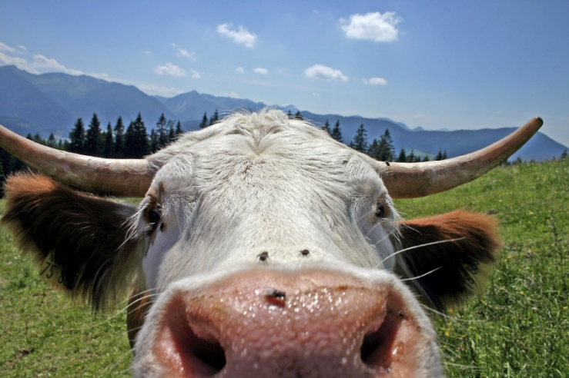
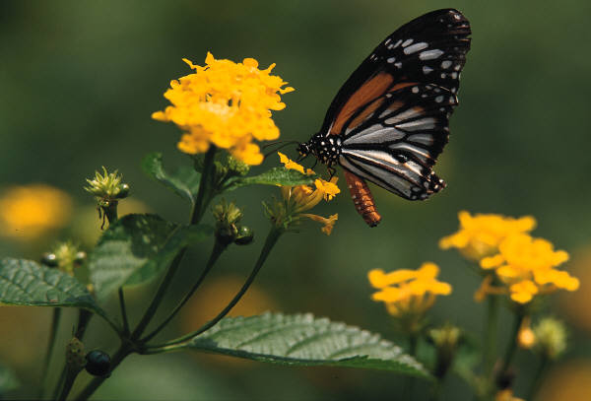
Animals & Plants Rely On Each Other
Animals use:
  Sugar (from producers/plants)
  Oxygen (from producers/plants)
Plants use:
  Carbon dioxide (from animals)

Slide 19
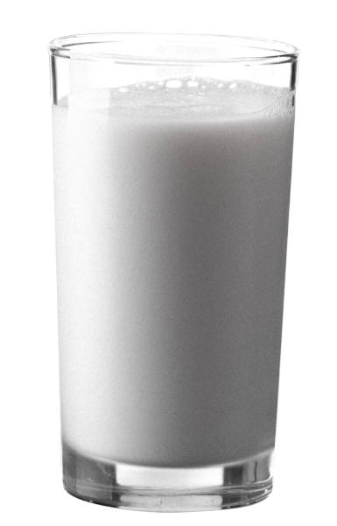
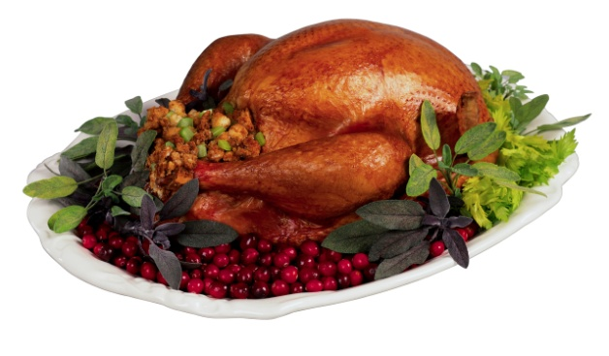
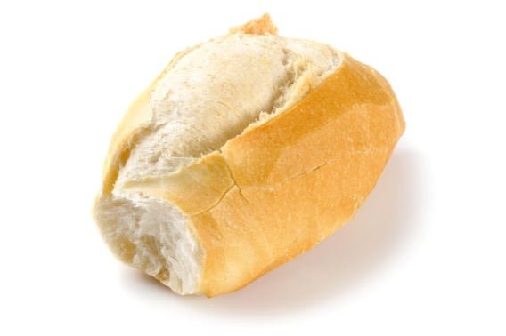
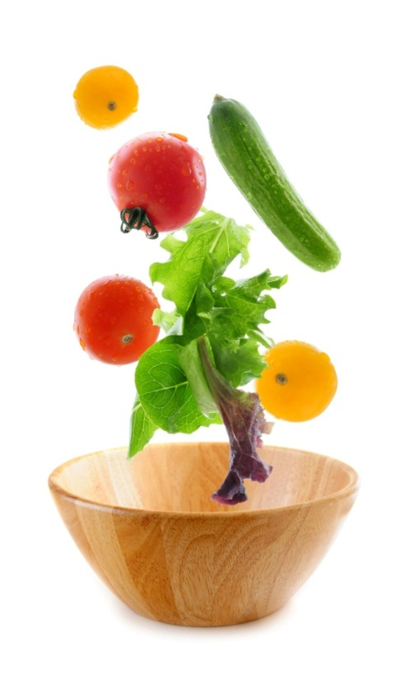
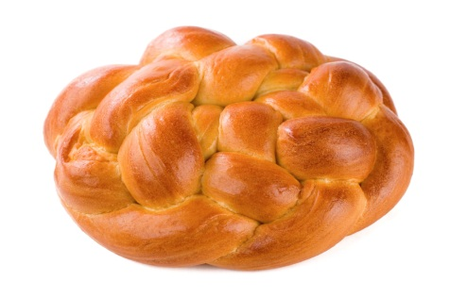
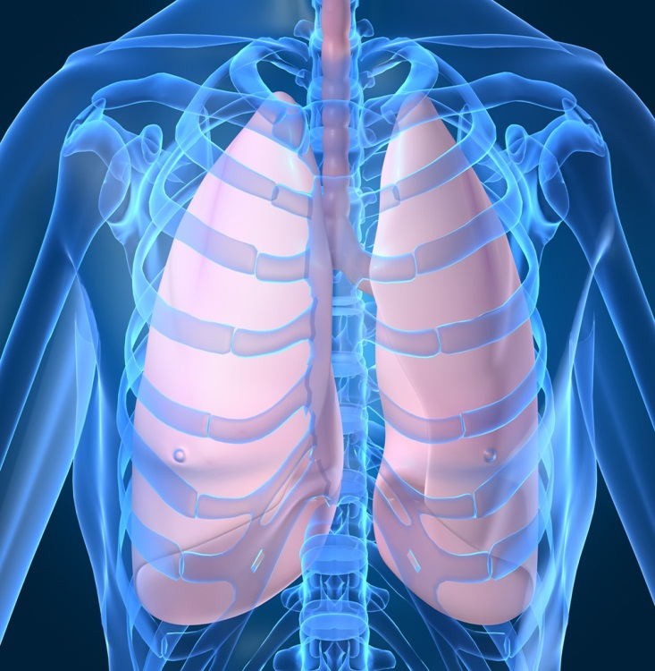
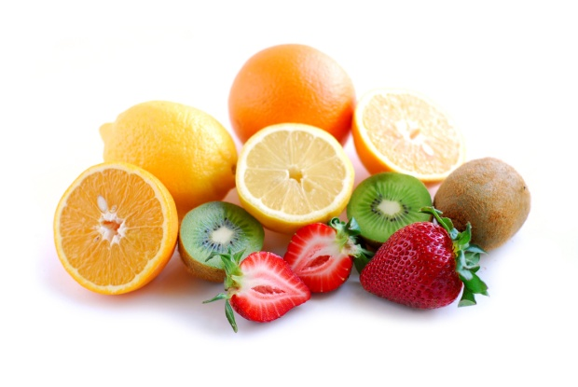
The mitochondria change the O2 and sugars (food)
O2
O2
O2
O2
O2

Slide 20
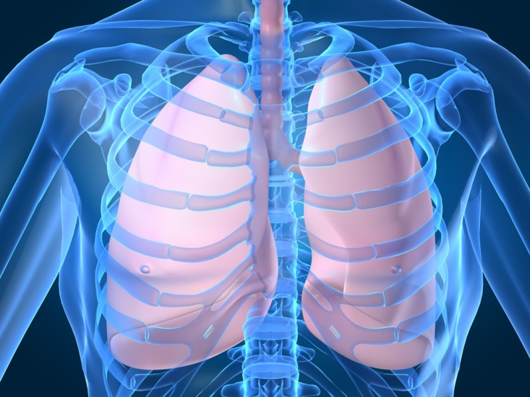
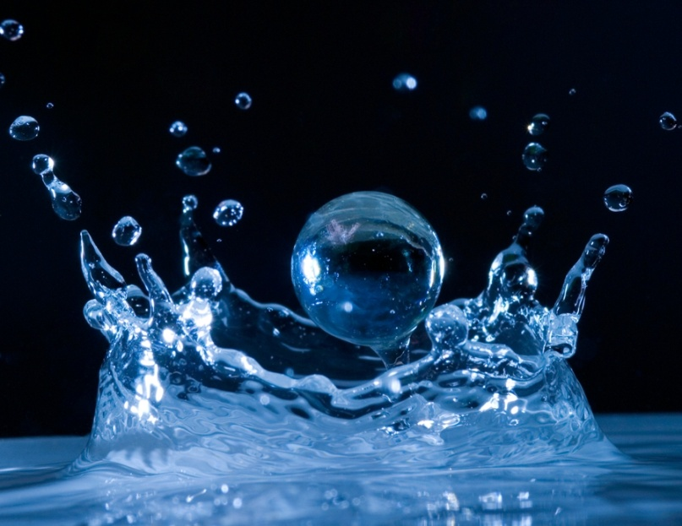
Into CO2, H2O, and ATP
ATP

Slide 21
Comparing Equations
Photosynthesis Equation:
H2O + CO2 + light → O2 + glucose
Respiration Equation:
O2 + glucose → H2O + CO2 + ATP
They are opposites of each other!

Slide 22
Aerobic/Anaerobic
Respiration

Slide 23
- Triathlon-
If somebody challenged you to a run a race, how should you prepare to win?
    Practice
    Eat the right foods
    Drink the right liquids

Slide 24
All living organisms break down sugars to get energy. In humans this breakdown usually occurs with oxygen.

Slide 25
Aim:
To understand how Aerobic and Anaerobic Respiration Occurs

Slide 26
SWBAT:
Learn how the type of sugar affects the rate of respiration.
Learn how the concentration of sugar affects the amount of energy produced.
Determine the rate of respiration while using yeast to breakdown different sugars.

Slide 27
What is Aerobic Respiration?
The breaking down of sugar to produce energy where oxygen is present.
Glucose + Oxygen → Carbon Dioxide + Water+ Energy

Slide 28
When We Exercise…
After two minutes of exercise, the body responds by supplying working muscles with oxygen.
When oxygen is present, glucose can be completely broken down into carbon dioxide and water

Slide 29
Anaerobic Respiration refers to the oxidation of molecules in the absence of oxygen to produce energy
It is also known
As Fermentation

Slide 30
What happens when fermentation occurs?
In Muscle Cells- During extraneous activities, the oxygen in the muscle tissue is decreased to an extent that aerobic respiration does not occur at a sufficient rate. Hence, there is a buildup of lactic acid and your muscles get tired
We call this lactic acid fermentation!
2. In Yeast- The fermentation end product is ethyl alcohol, and CO₂
We call this alcoholic fermentation!

Slide 31
Chemical Formula for Anaerobic Respiration
Energy + Glucose
Ethanol + Carbon Dioxide + Energy

