Slide 1
Microscopes Allow Us to See Inside the Cell
Section 1.2

Slide 2
How Small Are Cells?
Cells vary in size from roughly 1 micrometer (μm) 1000 micrometers
1 micrometer is one millionth of a meter
It would take 17,000 tiny bacteria cells to line up across the diameter of a dime!!
Remember, each of these is LIVING too!
How many bacteria cells are on the screen of your phone, or iPad for that matter?
WASH YOUR HANDS BEFORE YOU EAT

Slide 3
The Light Microscope
The light microscope allows us to see things with amazing detail at these sizes
Lenses are used to bend light and make objects appear larger
Can magnify objects up to 1000X
We can observe living cells with light microscopes!
Can also use video cameras and computers to observe movement
Can only be used for samples 0.2 micrometers or larger

Slide 4
Electron Microscope
Two different types:
Scanning Electron Microscope (SEM)
Transmission Electron Microscope (TEM)
They can show things as small as 0.002 micrometers, or more than 100 times smaller than the light microscope!
Particles called electrons are used to magnify and produce images
They can magnify images up to 1,000,000X!
However, CANNOT be used on living samples
Also, very expensive

Slide 5
Scanning Electron Microscope (SEM)
Sample is coated in a heavy metal
A beam of electrons is shot back and forth over the surface
The electrons bounce back off the coating and are read by the sensor/detector and a 3D image is created
Why does this not work on living cells?

Slide 6
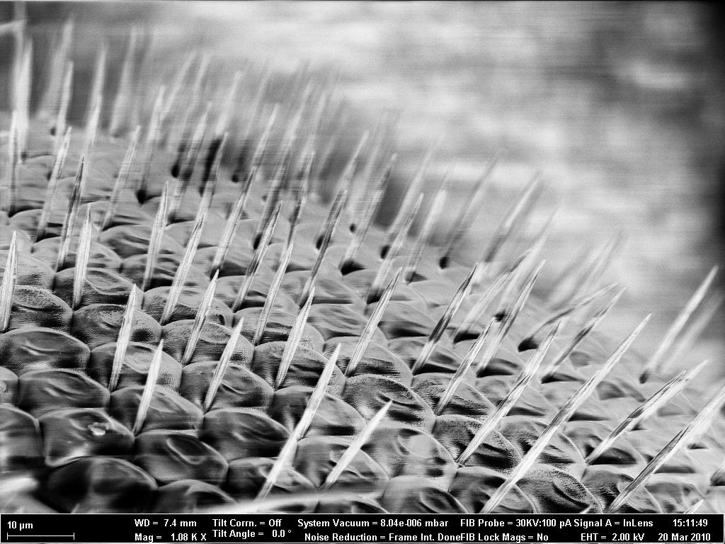
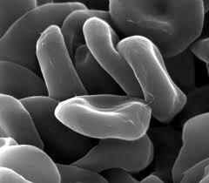
SEM Images
A Fruit fly’s compound eye
Bacteriophage – A virus that kills bacteria
Red Blood Cells

Slide 7
Transmission Electron Microscope (TEM)
Sample is sliced extremely thin
Electrons pass through the sample
Images are produced in a 2D picture

Slide 8
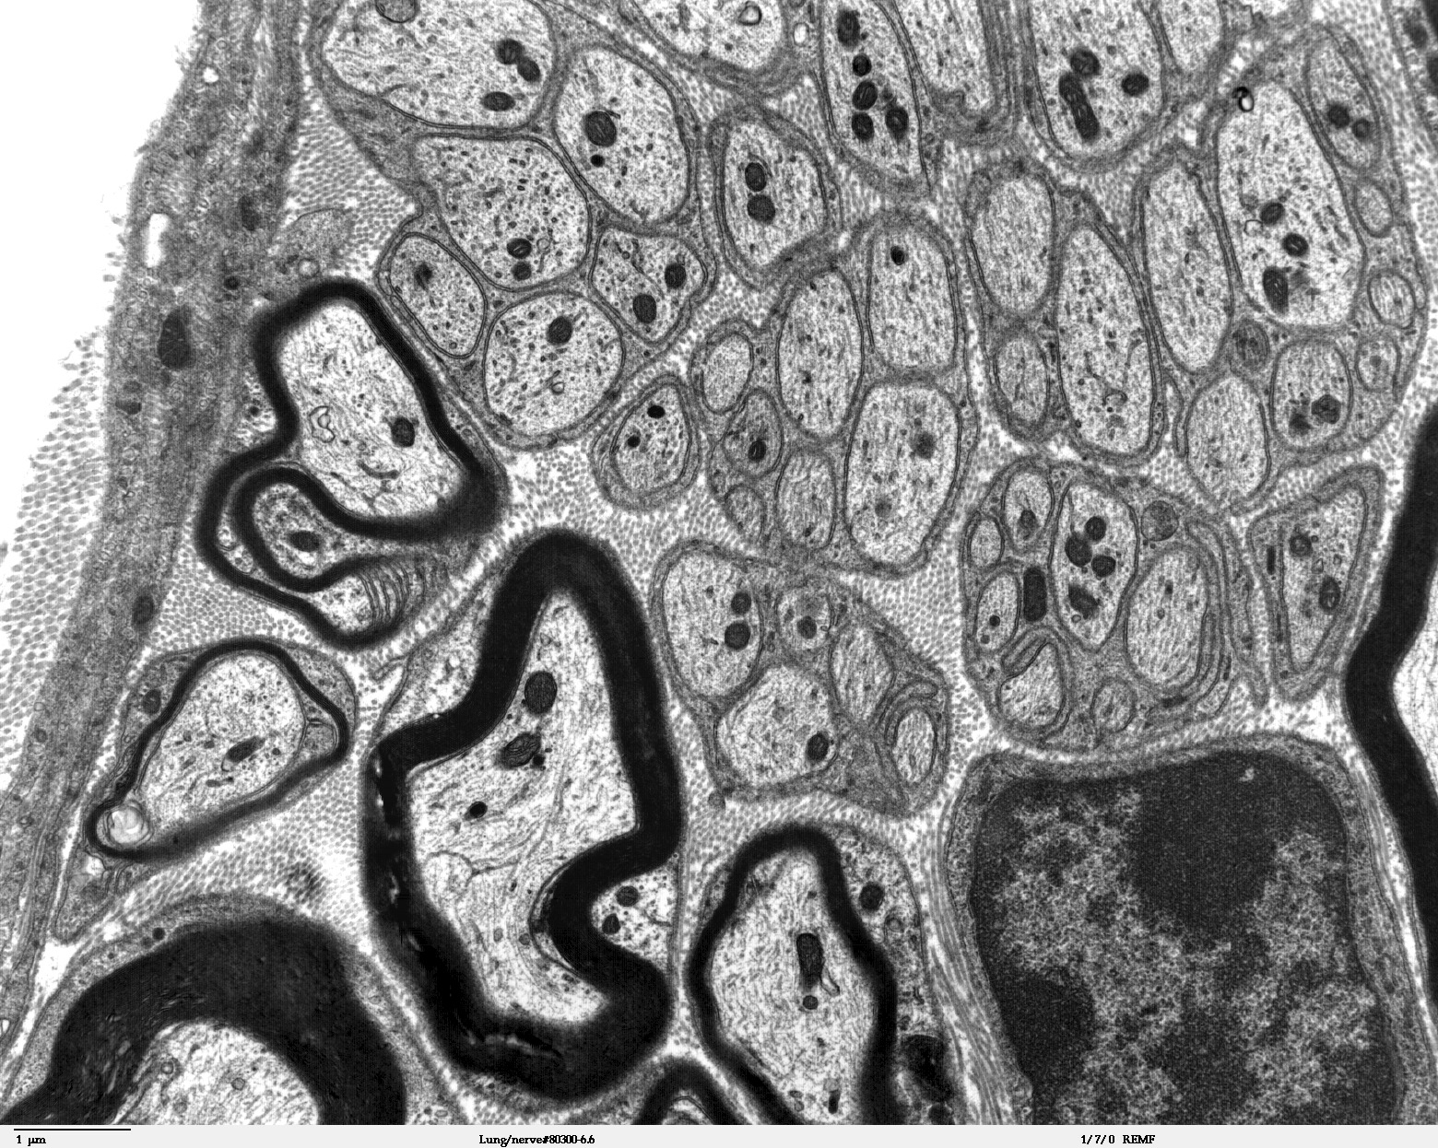
TEM Images
Mammal Lung
Liposome
Single Celled Algae

Slide 9
The Cell
Every cell has a Cell Membrane
The Cell Membrane is a protective covering that encloses the entire cell, it separates the inside from the outside of the cell
Inside the cell membrane is a fluid called the Cytoplasm. Most of the work in a cell is performed in the cytoplasm.
There are two broad categories of cells:
Prokaryotic
Eukaryotic
The difference is the location of the genetic material that the cell needs to reproduce

Slide 10
Eukaryotic Cells
The genetic material is enclosed in a structure called the nucleus
The Nucleus is enclosed by its own membrane
We use the word organelle to describe any part of a cell that is enclosed by a membrane, the nucleus is an example of this
Almost all multicellular organism are eukaryotic

Slide 11
Prokaryotic Cells
A Prokaryotic Cell has no separate compartment for the genetic material
All the genetic material is inside the cytoplasm
There are NO organelles
For the most part, unicellular organisms are prokaryotic cells. But there are exceptions.

Slide 12
Plant Cells
One unique structure is that they also have a Cell Wall
The Cell Wall is a tough outer covering that lies just outside of the cell membrane
This supports and protects the cell
It is one important way that plant cells are different from animal cells

Slide 13
Eukaryotic Cells
Divided into two main compartments:
The Nucleus
The Cytoplasm
Nucleus
The largest organelle in the cell
Stores all the genetic material for reproduction
Contains the instructions a cell needs in order to function
Cytoplasm
Gelatin-like fluid contained within the cell membrane

Slide 14
Other Important Organelles
Ribosome
Endoplasmic Reticulum
Golgi Body
Mitochondria
Vesicles

Slide 15
Ribosomes
Located just outside of the nucleus
Translates the information from the nucleus to help the cell carry out the instructions
Uses the information to gather materials a cell needs to build important molecules called proteins

Slide 16
Mitochondria
Mitochondria are the organelles that use oxygen to process food in order to manufacture energy in both plant and animal cells
Can think of these as the Powerhouse of the cell

Slide 17
Chloroplasts
Organelle in which the energy from sunlight is used to make sugar
Some of this is used immediately to keep the cells functioning, the rest of the sugar is stored
Animal cells DO NOT contain chloroplasts, must eat plants or eat animals that eat plants to get this energy

Slide 18
Endoplasmic Reticulum (E.R.)
Long twisting membranous organelle
Some of the ER contains ribosomes (rough ER) which manufacture proteins
The ER also manufactures parts of the cell membrane
Part of the cell transport system => parts break off in the form of vesicles

Slide 19
Golgi Apparatus
Golgi apparatus takes the materials in the vesicles made from the ER and finishes processing them
Also involved in secretion and intracellular transport

Slide 20
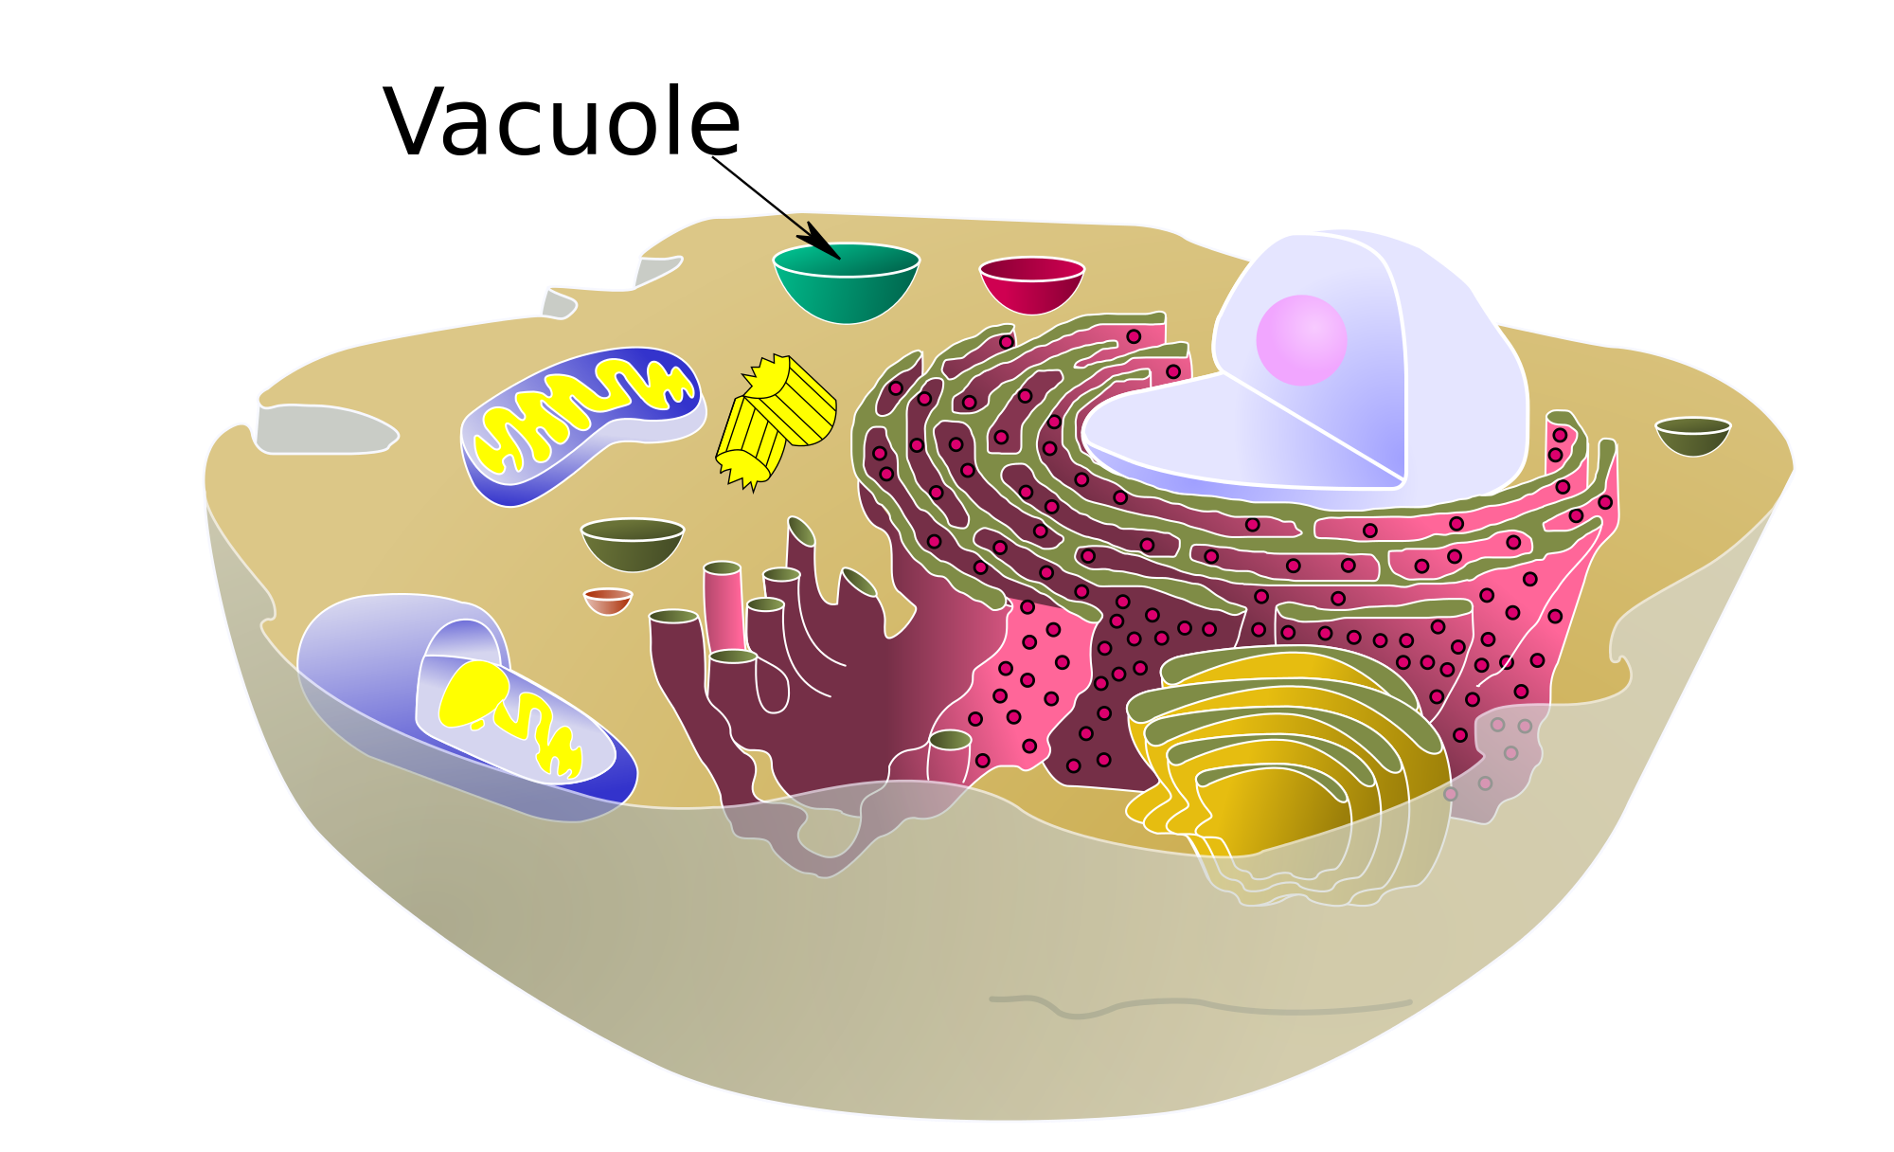
Vacuoles
Vacuoles are enclosed by a membrane and can hold water, waste, and other materials
They move these materials into and out of the cell, functioning with the cell membrane to facilitate this
A plant cell has a large central vacuole in which water and other materials are stored

Slide 21
Lysosomes
Animal cells do not have large central vacuoles
They do have lysosomes which are vesicles that contain chemicals that break down materials taken into the cell, as well as old cell parts
Animal cells take in food right?
Why do they need lysosomes?

Slide 22
Plant Cell

Slide 23
Animal Cell

