Slide 1
HUMAN POPULATIONS HAVE UNIQUE RESPONSES TO CHANGE
Human Populations differ from populations of other Species:
  Humans are able to shape their environment & determine their own biological reproduction
  Because humans can control many factors that limit growth, Earth’s carrying capacity for humans has increased (due to habitat expansion & technology)

Slide 2
Continued
Human Populations are Growing
Human Population Growth affects the Environment:
As human population grows, it contributes to the decline & extinction of other populations. (some say over 99% of Earth’s total species are now extinct).
Human Populations put pressure on environment in many ways (introduce new species, & pollution)

Slide 3
Habitat Expansion
Over time, human populations have spread over nearly the entire planet.
Habitat = place where an organism can live. Humans expanded theirs allowing population growth. By adding air conditioning or heat, & unique buildings, humans can build shelters to protect from harsh environments.

Slide 4
Technology
Humans have found a way to fit themselves into almost every climate by altering their clothing, shelter, diet, & means of transportation.
Scientific discoveries & technology(better sanitation, medical care) have increased the standard of living and life expectancy of many humans.
Important goods (food/shelter) are shipped around the world; water (a limited resource) can be transported through pipes to irrigate fields or reach dry areas and it can be purified to drink or be released back into the environment.

Slide 5
History of Human Population Growth
Until 300 years ago, human population grew slowly (disease/climate/limited resources/early deaths)
Today, populations in much of the world are increasing rapidly due to 3 main things:
  ¹Availability of resources;²lack of predators; ³survival of offspring to reproductive age.

Slide 6
Population Projections
Scientists make predictions called population projections to help prepare for the future. These forecast how a population will change, based on its present size & age structure(& ages of people having kids, average # of kids they have, life expectancy & health in a population).
Government agencies, resource managers & economists use projections to plan to meet future needs of a population.
Factors affecting population growth vary from society to society:
  HIV/AIDS have lowered population projections in some African countries for 2015 by 18%. In Botswana, the average life expectancy dropped from 63 (in late 80s) to 32 years in 2003. Because many who die are in reproductive years, this could greatly affect population.

Slide 7
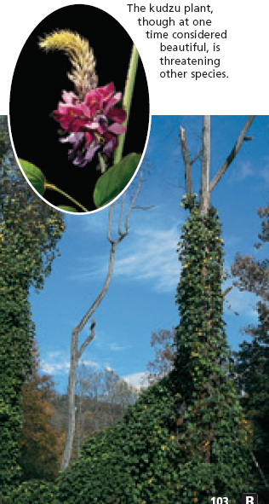
Introduce New Species
Travelers have introduced new species to areas both on purpose & accidentally. Many new species have benefits (beauty/food) but some cause great harm to ecosystems.
  Zebra Mussel accidentally released into Great Lakes region from Europe by ocean vessel. No natural predators, so reproduced greatly to compete with native species for food, & is negatively affecting water quality, especially in the Midwest
  Kudzu plant imported from Japan into Southeast to keep soil from washing away. Its starch is key ingredient in some Asian recipes. But grew too fast & too far (about a foot/day) killing trees & other plants in habitat.

Slide 8
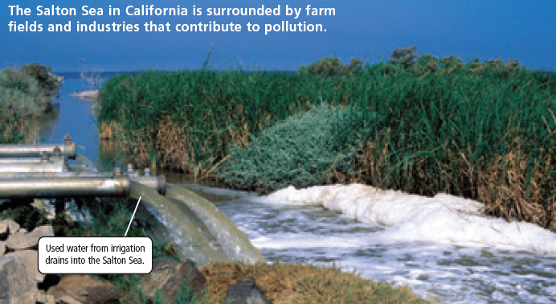
Pollution
Pollution= addition of harmful substances to environment.
Hog farming has grown & caused a lot of pollution. Between 1987-2001, North Carolina hog population grew from 2.6-10 million (50,000 tons of waste/day, affecting water supplies, soil & air quality).
Chemical dumping from industries & pesticide runoff from nearby farms has caused pollution in the Salton Sea in CA. The rivers running into it carry high levels of harmful chemicals, causing weaker egg shells for local birds (so birds die) and malformed fish.

Slide 9
OVERFISHING
Many species of fish/crustaceans have been overfished with better techniques, that if they can’t reproduce quickly enough, their populations may not recover.
The demand for lobster increased so much in recent times, that areas fished for years are now barely supplying any, and they are smaller.
Laws have been enforced to help the populations to recover; females with eggs must be released, only mature lobsters may be kept.

