Slide 1
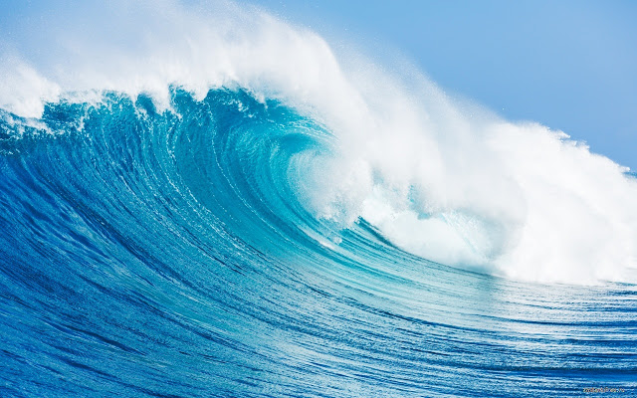
Waves
By David Weber, Owen Johnson, Matthew Jacobsen, and Connor Black.

Slide 2
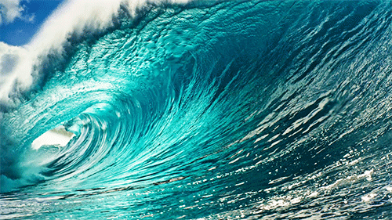
What are waves?
A wave is an up-and-down motion along the surface of a body of water.
The ocean surface is covered with various sizes of waves.

Slide 3
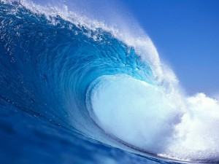
How do waves form?
Waves are usually caused by wind.
Moving air drags across the ocean surface and energy passes to the waves and causes energy.
Waves are also caused by earthquakes, landslides, and underwater volcanic eruptions.

Slide 4
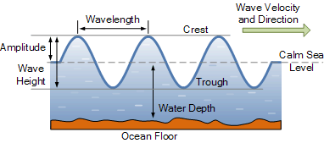
Wave Structure
The Crest of the wave is the highpoint of the wave
The Trough of the wave is the low point of the wave
The Wave Height is the vertical distance between the top of the crest and the bottom of the trough
The Wavelength is the distance between one wave crest and the next

Slide 5
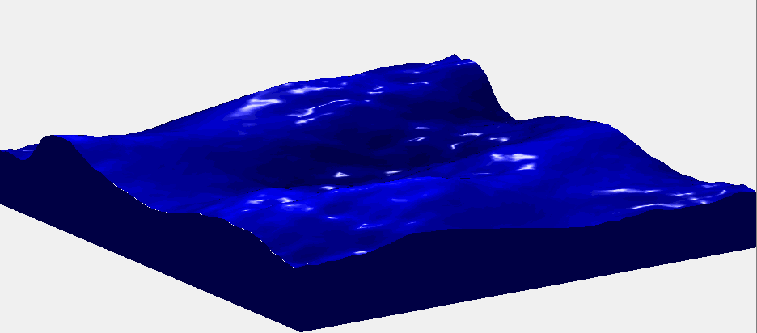
Wave Action Near Shore
Waves go for very far lengths until they get close to the shore
The waves eventually lose speed then topple over losing all their energy and then break at the shore.
When the waves hit the beach the water sinks into the sand and slides back down into the undertow
The undertow is the pull of the water as it runs back into the sea
Undertows can be dangerous because some can knock people off their feet into the waves.

Slide 6
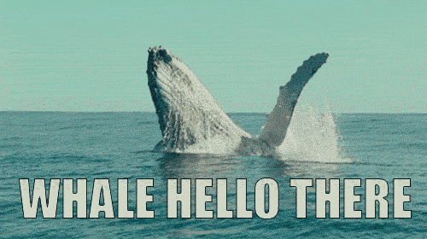
What is the importance of waves?
waves can be fun and useful to surfers and to the environment
Long-traveled swells are a very important to the long and complex web of mechanisms that control the heat balance on the planet.

Slide 7
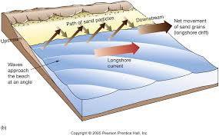
What are Longshore Currents?
Sometimes swimmers drift far from the beach without trying. They drifted because of a longshore current.
Longshore currents move water parallel to the shore.
Longshore currents occur in places where waves meet land at an angle.
There is a longshore current along basically every shore.

Slide 8
Rip Currents
Rip currents are narrow streams of water that break through sandbars and drain rapidly back to sea.
Rip currents happen when high winds or waves cause a larger-than-usual amount of water to wash back to shore
Like undertows Rip Currents can be deadly.
In the U.S around 100 people drowned because of rip currents each year!
You cannot swim against a rip current so stay away and beware!

Slide 9
Q & A
1. What is the crest of the wave?
2.How does moving air form waves in water?
3.What are Rip Currents?

Slide 10
Answers
1.The crest of the wave is the highpoint.
2. The wind blows up water and forms waves.
3. Narrow Streams of water that break through sandbars.

Slide 11
YouTube Videos (our sources)
https://www.youtube.com/watch?v=k1EQtkCI0WI
https://www.youtube.com/watch?v=-OeqKLiEwZ0

