Slide 1
Communication and Control
Life Science Chapter 4

Slide 2
The Nervous System
Life Science 4.1

Slide 3
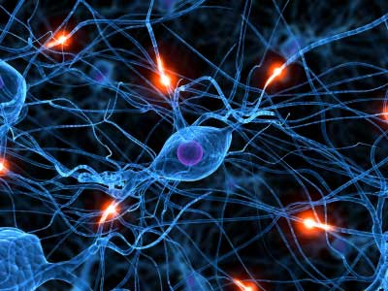
Objectives:
Describe the relationship between the central nervous system and the peripheral nervous system.
Compare the somatic nervous system with the autonomic nervous system.
List one function of each part of the brain.

Slide 4
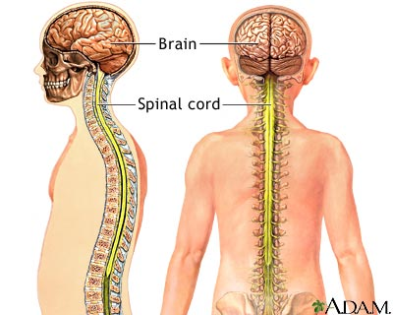
Two Systems Within a System
Central nervous system (CNS)
Your brain and spinal cord.
Processes and responds to all messages coming from the peripheral nervous system.
Peripheral nervous system (PNS)
All of the parts of the nervous system except for the brain and the spinal cord.
Connects all parts of the body to the CNS.

Slide 5
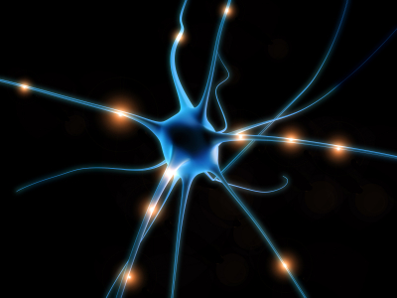
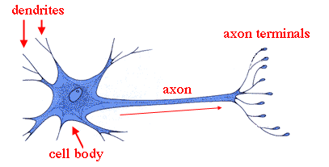
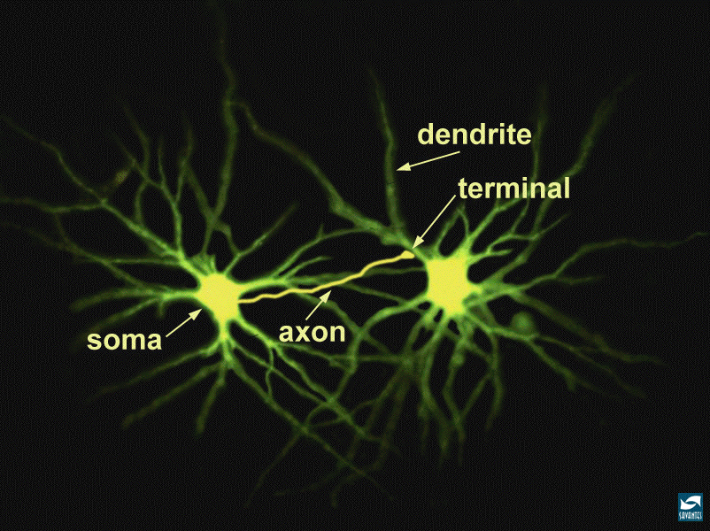
The Peripheral Nervous System
Neuron
Nerve cell that is specialized to transfer messages in the form of fast-moving electrical energy.
The three parts of a neuron are :
Cell body
Dendrites
Axon.
Sensory neurons
Gather information about what is happening in and around your body.
Motor neurons
Send impulses from the brain and spinal cord to other systems.

Slide 6
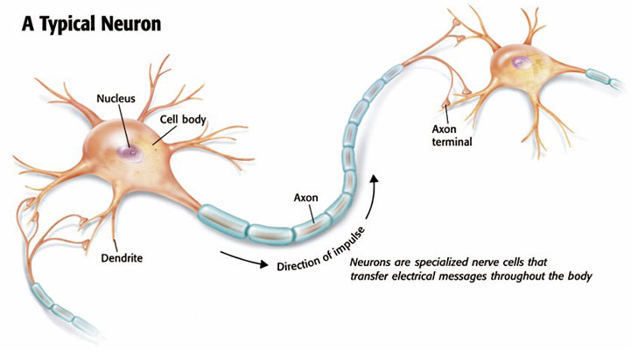

Slide 7
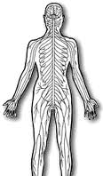
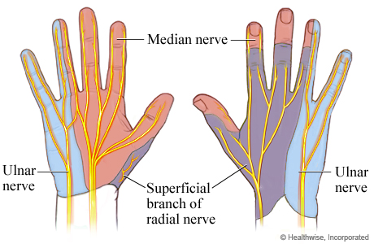
Nerves
The central nervous system is connected to the rest of your body by nerves.
Nerve
Collection of axons bundled together with blood vessels and connective tissue.
Most nerves have axons of both sensory neurons and motor neurons.

Slide 8
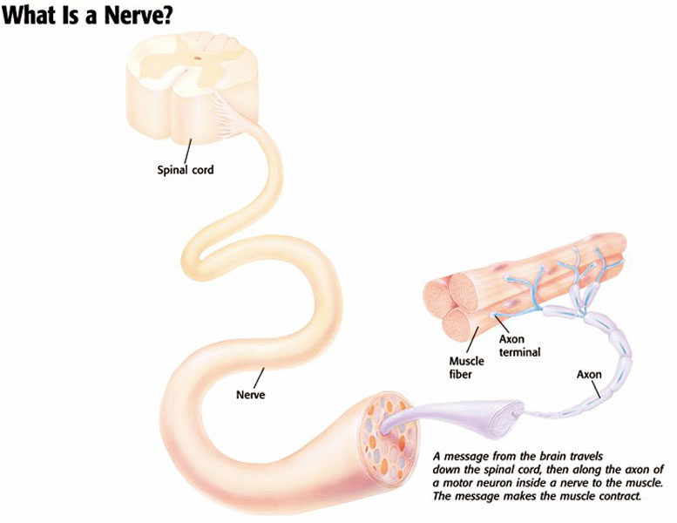

Slide 9
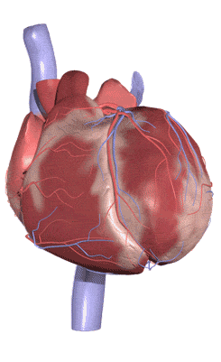
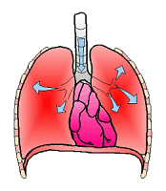
Somatic and Autonomic Nervous Systems
Somatic Nervous System
Most of these neurons are under your conscious control.
Control voluntary movements such as: writing, talking, smiling, and jumping.
Autonomic Nervous System
Do not need your conscious control.
Controls body functions that you don’t think about, such as digestion and heart rate.

Slide 10
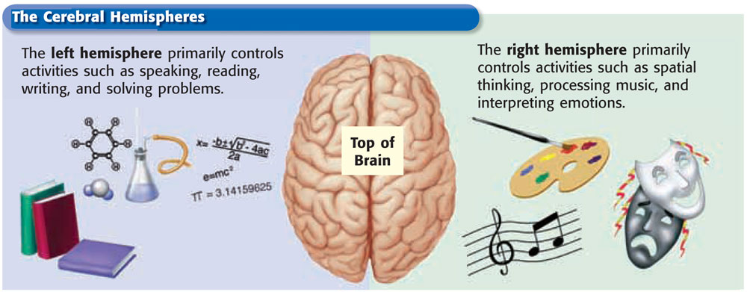
The Central Nervous System
The brain
Largest organ of the nervous system.
Main control center of the nervous system.
Controls both voluntary and involuntary processes.
Comprised of the cerebrum, the cerebellum, and the medulla.

Slide 11
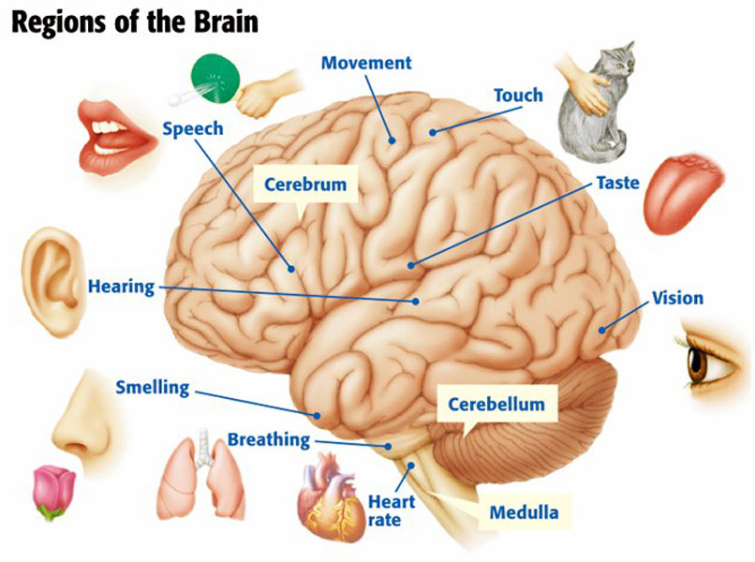
Cerebrum
Where you think and where most memories are stored.
Controls voluntary movements and the senses.
Cerebellum
Processes sensory information from your body
Such as : skeletal muscles and joints.
Medulla
Controls involuntary processes such as blood pressure, body temperature, heart rate, and involuntary breathing.

Slide 13
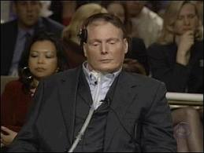
The Spinal Cord
Route to the Brain
The spinal cord is made of neurons and bundles of axons that pass impulses to and from the brain.
The spinal cord is surrounded by protective bones called vertebrae.
Spinal Cord Injury
A spinal cord injury may block all information to and from the brain. Each year, thousands of people are paralyzed by spinal cord injuries.

Slide 14
